Slide 1
Metaheuristics
Lec – 2

Slide 2
Single State Methods

Slide 3
Gradient-based Optimization…
Big Assumptions:
you can compute the first derivative
or even the second derivative
These assumptions are valid only if the function is:
well-formed and well-understood
However, in most cases:
you don’t even know what the function is
So, you can’t compute the gradient of the function
All you have is:
a way of creating or modifying inputs to the function
i.e., candidate solutions
testing them
assessing their quality

Slide 4
An Example:
Imagine that you have a humanoid robot simulator.
Your goal is to find an optimal loop of timed operations to keep the robot walking forward without falling over.
You have some n different operations
So, your candidate solutions are arbitrary-length strings of these operations.
You can plug a string in the simulator and get a quality out
how far the robot moved forward before it fell over
Now the big question is:
How do you find a good solution?

Slide 5
Our Scenario…
Solution quality
Candidate solution
Candidate solution
Candidate solution
Problem
Candidate solution
Candidate solution

Slide 6
How to do Optimization???
We need to be able to do 4 things:
Provide one or more initial candidate solutions.
Assess the Quality of a candidate solution.
Make a Copy of a candidate solution.
Tweak a candidate solution, which produces a randomly slightly different candidate solution.
Initialization
Procedure
Assessment
Procedure
Modification
Procedure

Slide 7
Metaheuristics Provide…
Initialization Procedure
Assessment Procedure
Modification Procedure
and
Selection procedure
Decides which candidate solutions to retain and which to reject as it wanders through the space of possible solutions to the problem.

Slide 8
Hill Climbing

Slide 9
Hill Climbing vs Gradient Ascent
HC is related to Grad. Asc.
doesn’t require you to know the strength of the gradient or even its direction
Main Steps:
iteratively test new candidate solutions in the region of your current candidate
adopt the new ones if they’re better.
This enables you to climb up the hill until you reach local optima.

Slide 10
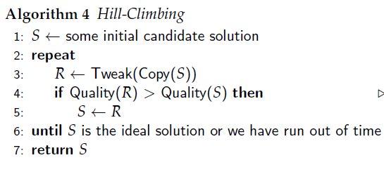

Slide 11
Initialization
Procedure

Slide 12
Modification
Procedure

Slide 13
Assessment and
Selection
Procedure

Slide 14
Difference between H.C. and Grad. Asc.
Tweak operation rely on a stochastic (partially random) approach to hunting around for better candidate solutions.
Sometimes it finds worse ones nearby, sometimes it finds better ones.

Slide 15
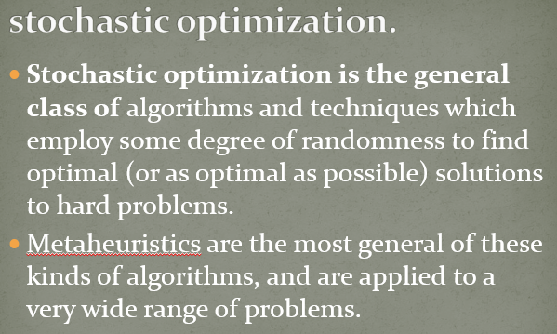
Difference between H.C. and Grad. Asc.
Recall:
Tweak operation rely on a stochastic (partially random) approach to hunting around for better candidate solutions.
Sometimes it finds worse ones nearby, sometimes it finds better ones.

Slide 16
More Aggression…
create n “tweaks” to a candidate solution all at one time, and then adopt the best one.
This modified algorithm is called Steepest Ascent Hill-Climbing,
We are sampling all around the original candidate solution and then picking the best
i.e., we’re essentially sampling the gradient and marching straight up it.

Slide 17
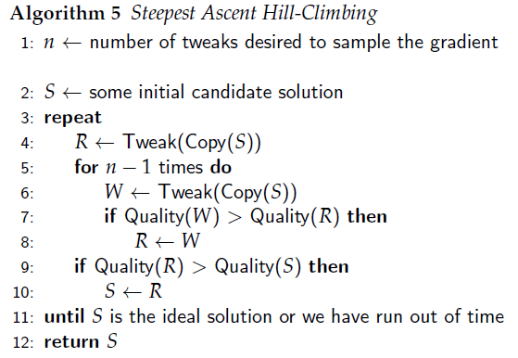

Slide 18
Tweaking on (the same) S in total of n times and taking the best one.

Slide 19
A Popular Variation…
Do not bother comparing R to S; just replace S directly with R.
But we may lose our best solution of the run
So, we keep the best-discovered-so far in a reserve variable

Slide 20
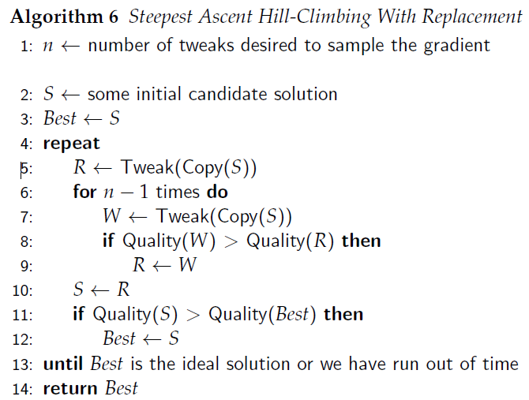

Slide 21
n tweaks
replace S with R without comparing
keep the best-discovered-so far in a reserve variable

Slide 22
Representation
(Very Briefly)

Slide 23
Representation of a candidate Solution
“Representation” is defined by:
Initialization
Copy
Tweak
Assessment Function
What might a can. Sol. Look like?
Vector
List
Collection
Tree
Graph
Combination of above
What is a can. Sol. made up of
How it operates
If you can create the four functions above in a reasonable fashion, you’re in business.

Slide 24
Representation of a candidate Solution
“Representation” is defined by:
Initialization
Copy
Tweak
Assessment Function
What might a can. Sol. Look like?
Vector
List
Collection
Tree
Graph
Combination of above
We will use
fixed-length vector of real-valued numbers mostly.

Slide 25
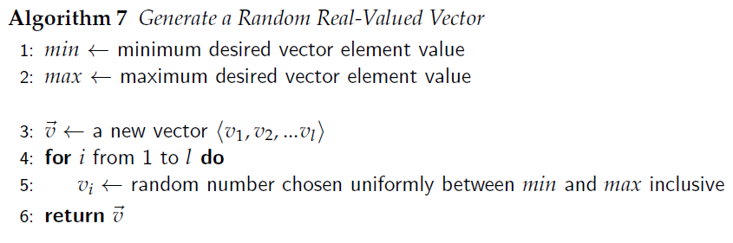
Initialization: Creating a random Vector

Slide 26
Tweak a Vector…
add a small amount of random noise to each number
i.e., adding bounded, uniformly distributed random noise to a vector.
How to do this?
For each slot in the vector, if a coin-flip of probability p comes up heads, we find some bounded uniform random noise to add to the number in that slot.

Slide 27
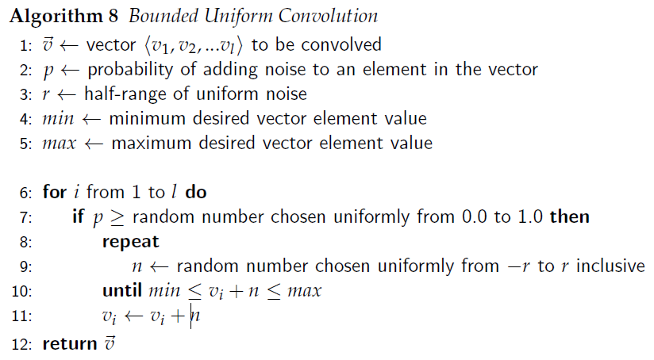


Slide 28
A useful “knob”
Check the limits

Slide 29
Small r…
If the size is very small, then Hill-Climbing will march right up a local hill and be unable to make the jump to the next hill
bound is too small for it to jump that far. Once it’s on the top of a hill, everywhere it jumps will be worse than where it is presently, so it stays put.
Further, the rate at which it climbs the hill will be bounded by its small size.
So, Small r => H.C. moves slowly and gets caught in local optima

Slide 30
Large r…
if the size is large, then Hill-Climbing will bounce around a lot.
when it is near the top of a hill, it will have a difficult time converging to the peak, as most of its moves will be so large as to overshoot the peak.
large r => H.C. bounce around too frenetically and cannot converge rapidly to finesse the very top of peaks.

Slide 31
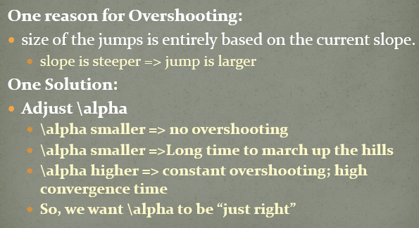
Small r => H.C. moves slowly and gets caught in local optima
large r => H.C. bounce around too frenetically and cannot converge rapidly to finesse the very top of peaks.
Recall:

Slide 32
Knob r: Exploration vs Exploitation
r is one way of controlling the degree of Exploration versus Exploitation in Hill-Climber.
Exploitation: Optimization algorithms which make largely local improvements are exploiting the local gradient.
Exploration: algorithms which mostly wander about randomly are thought to explore the space.
rule of thumb:
you’d like to use a highly exploitative algorithm
it’s fastest
but the “uglier” the space, the more you will have no choice but to use a more explorative algorithm.

Slide 33
Single-State Global Optimization Algoritms

Slide 34
Global Optimization Algorithms
If a GOA runs for long enough, it will eventually find the global optimum
The way this is done is by guaranteeing that, at the limit, every location in the search space will be visited.
So far, we have considered small tweaks
If we’re stuck in a sufficiently broad local optimum, small Tweak may not be strong enough to get us out of it.
Thus the algorithms so far have been local optimization algorithms.

Slide 35
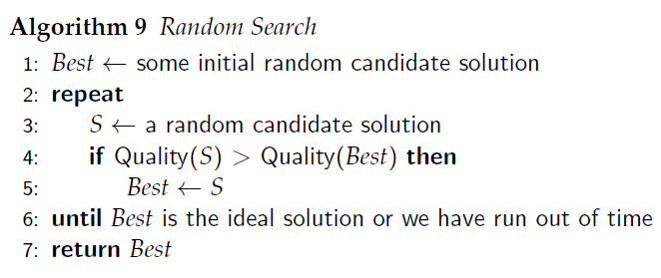
Simplest Global Opt. Alg.

Slide 36
Exploration vs Exploitation
Random Search is the extreme in exploration
This is global optimization
Hill-Climbing with small Tweak may be viewed as the extreme in exploitation
This is local optimization
Our Goal:
Achieve reasonable exploitation and still have a global algorithm
Something, halfway between the two above☺

Slide 37
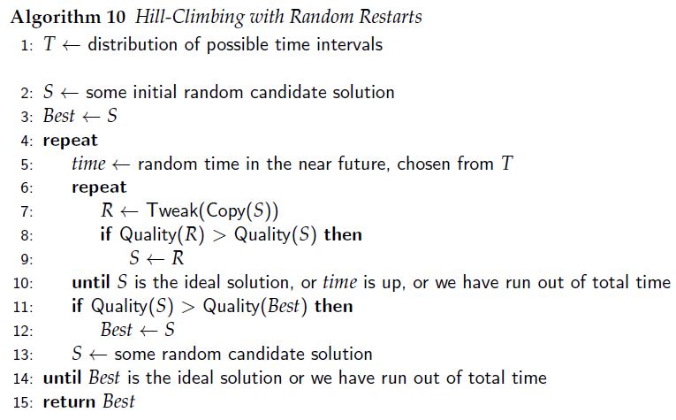

Slide 39
Hill
Climbing
Random Search

Slide 40
Here, time is a knob!
Long time => one big Hill-Climbing.
Short time => random search
resetting to random new locations each time.
Moderate time => problem solved! (REALLY?)
Hill
Climbing
Random Search

Slide 41
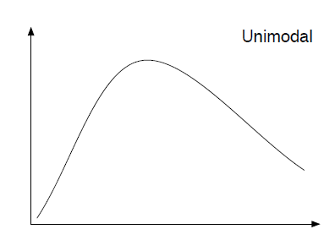
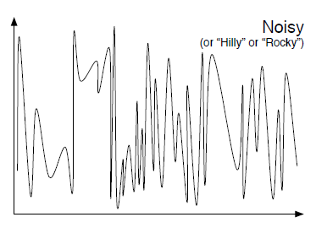
Unimodal vs Noisy
H.C. is close to optimal
Rand. Search is bad
H.C. is quite bad
Rand. Search is as good as you can get

Slide 42
Unimodal vs Noisy: Smoothness
Smooth
there is a strong relationship between the distance (along the x axis) of two candidate solutions and their relationship in quality: similar solutions are generally similar in quality
there’s no relationship like this: even similar solutions are very dissimilar in quality

Slide 43
Smoothness…
In general:
Smoothness helps Hill climbing
But this is not sufficient…

Slide 44
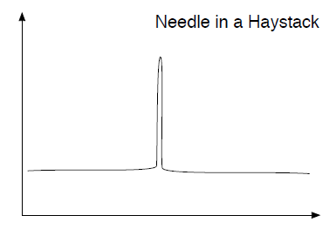
This is pretty smooth!
But Hill Climbing doesn’t work well
Random Search is the only way to go.
In fact, for local search to be effective there must be an informative gradient which generally leads towards the best solutions

Slide 45
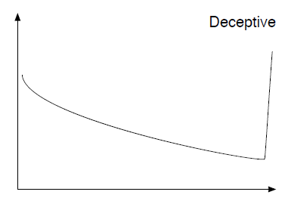
uninformative gradients
Here Hill-Climbing is spectacularly bad!
In fact, here, Hill-Climbing is actively going away from the optimum.

Slide 46
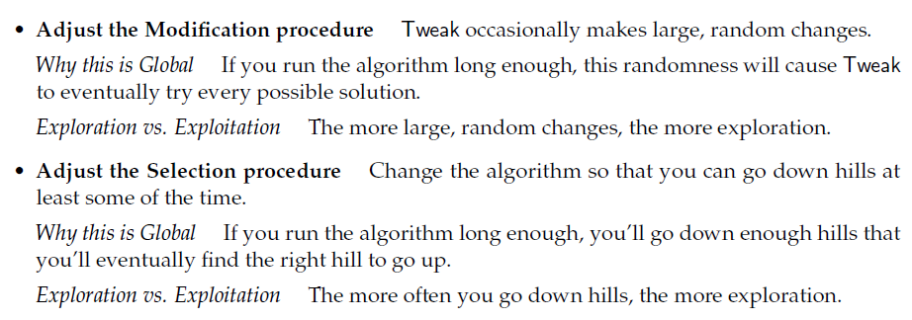
Ways to be global…
Sometimes, keep the tweaked solution that is worse!

Slide 47
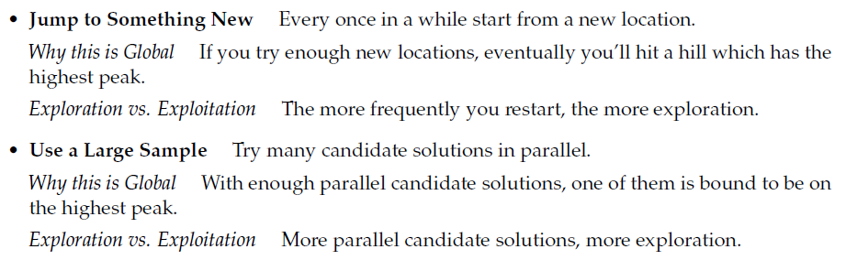
Ways to be global…

Slide 48
Adjusting the Modification Procedures

Slide 49
Variation of Tweak…
Goal:
construct a Tweak operation
which tends to tweak in small ways
but occasionally makes larger changes,
and can make any possible change.
We’ll mostly hill-climb,
But also have the ability to, occasionally, jump far enough to land on other peaks.
And there is a chance, however small, Tweak will land right on the optimum

Slide 50
Recall our Tweak…
Alg. 8 chooses between
being small enough to finesse local peaks
And being large enough to escape local optima.
r was our knob!!
WE NEED BOTH
Solution?
Gaussian (Normal) Distribution, N(\mu, \sigma^2)

Slide 51
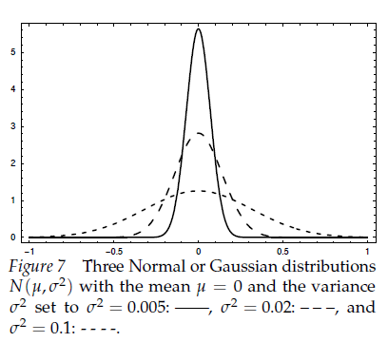
Gaussian Distribution…
usually it makes small numbers
sometimes it makes large numbers.
The distribution requires two parameters:
the mean \mu (usually zero)
variance \sigma^2.
small vs large numbers can be controlled by simply changing the variance \sigma^2 of the distribution.

Slide 52
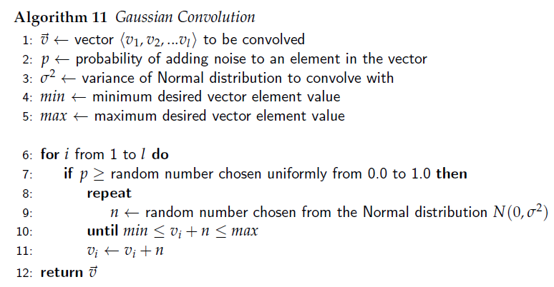

Slide 53
With Gaussian Convolution this algorithm is called (1+1)

Slide 54
With Gaussian Convolution this algorithm is called (1+\Lambda)

Slide 55
With Gaussian Convolution this algorithm is called (1,\Lambda)

Slide 56
Reason for such Cryptic names:
Will be discussed in the next chapter…

Slide 57
Again, Exploration vs. Exploitation…
(how many children are generated from the parent)
Gaussian Convolution
Now we have two knobs.
n and \sigma^2

Slide 58
Exploration vs. Exploitation…
n interacts with \sigma^2 in an important way:
\sigma^2 controls noise
Noise is higher => algorithm will search crazier locations:
n is higher => algorithm will aggressively weed out the poor candidates discovered at those locations.
n is low => a poor quality candidate may still be the best of the n examined;
\sigma^2 is pushing for more exploration (at the extreme: random search),
n is pushing for more exploitation.

Slide 59
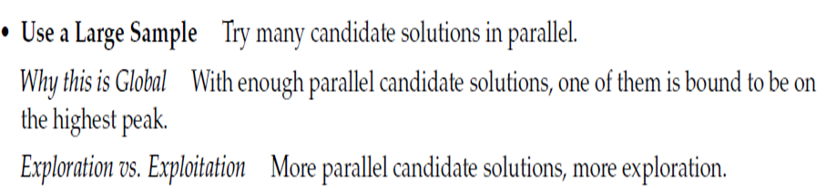
Don’t get confused….
n interacts with \sigma^2 in an important way:
\sigma^2 controls noise
Noise is higher => algorithm will search crazier locations:
n is higher => algorithm will aggressively weed out the poor candidates discovered at those locations.
n is low => a poor quality candidate may still be the best of the n examined;
\sigma^2 is pushing for more exploration (at the extreme: random search),
n is pushing for more exploitation.

Slide 60
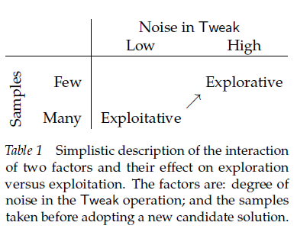
Exploration (\sigma^2) vs. Exploitation (n)…
Controlled by \sigma^2
Controlled by n

Slide 61
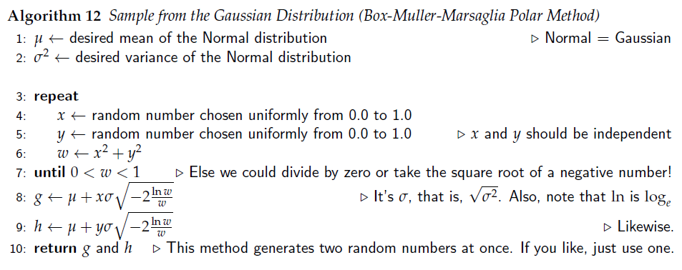
Gaussian Random Number Generators

Slide 62

Random Number: Normal to Gaussian…
Some random number generators (such as java.util.Random) only provide Gaussian random numbers from the standard normal distribution N(0, 1).
\mu = 0 and \sigma^2 = 1 => Normal Distribution
You can convert these numbers to a Gaussian distribution for any mean \mu and \sigma^2 as follows:

Slide 63
Simulated Annealing

Slide 64

Sim. Ann. Vs Hill Climb.
SA differs with HC in the decision of when to replace S with R
S is the original candidate solution.
R is its newly tweaked child.
if R is better than S, we’ll always replace S with R as usual.
What about, if R is worse than S?
we may still replace S with R with a certain probability P(t, R, S):
t >= 0
the algorithm sometimes goes down hills!!

Slide 65
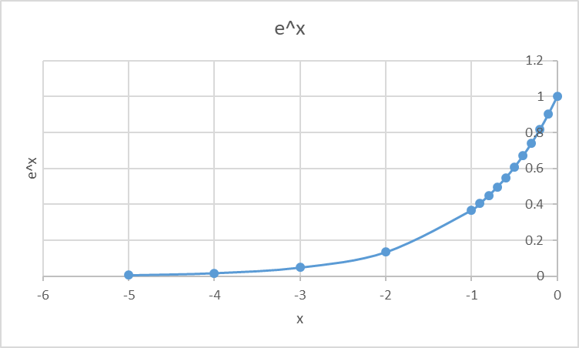
P(t, R, S): The Fraction
Note that R is worse than S.
So, Quality(R) < Quality(S)
So, the fraction is negative
if R is much worse than S, the fraction is larger, and so the probability is close to 0.
If R is very close to S, the probability is close to 1.
R isn’t much worse than S => we’ll still select R with a reasonable probability.

Slide 66
P(t, R, S): The tunable Parameter, t
We have a tunable parameter t.
t close to 0
=> the fraction is again a large number
=> the probability is close to 0.
t is high
=> the probability is close to 1.

Slide 67
The idea is to initially set t to a high number:
So P(t, R, S) is close to 1
The algorithm moves to every newly-created solution regardless of how good it is.
We’re doing a random walk in the space.
Then t decreases slowly
So P(t, R, S) decreases slowly eventually to 0:
Now the algorithm is doing nothing more than plain Hill-Climbing.

Slide 68
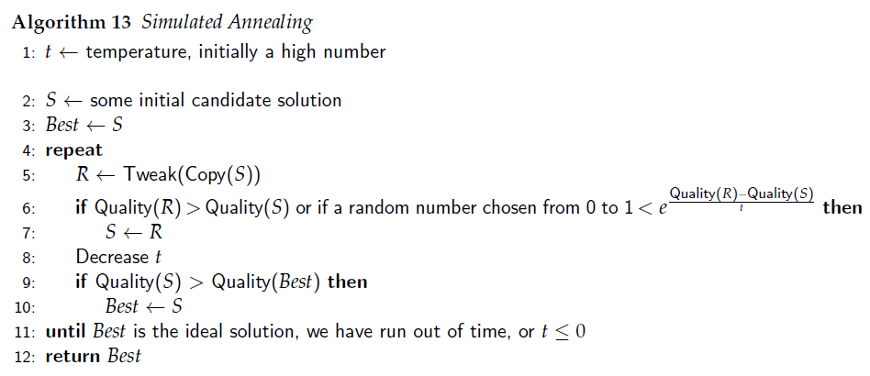

Slide 69
The rate at which we decrease t is called the algorithm’s schedule.
The longer the schedule, the longer the algorithm resembles a random walk and the more exploration it does.

Slide 70
We will replace S with R if R has better quality
Otherwise, we may still replace based on P(t, R, S)!

Slide 71
Tabu Search

Slide 72
Main Idea…
a different approach to doing exploration
Keeps a Tabu List: records of recently considered candidate solutions
refuses to return to those candidate solutions until they’re sufficiently far in the past.
Thus if we wander up a hill, we have no choice but to wander back down the other side
we’re not permitted to stay at or return to the top of the hill, at least for a sufficient amount of time.

Slide 73
Simplest Approach of Tabu Search
Maintain a tabu list L, of some maximum length l,
Whenever we adopt a “new” (i.e., not in L) candidate solution, it goes in to L.
If L is too large, we remove the oldest candidate solution
it’s no longer ‘taboo’ to reconsider.

Slide 74
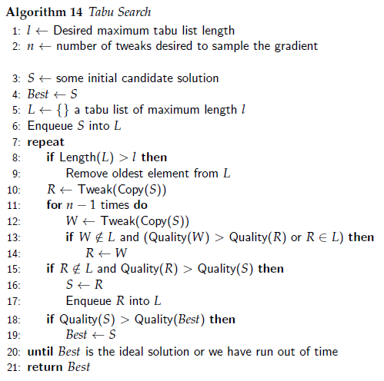


Slide 75
n tweaked children, but only consider the ones which aren’t presently taboo

Slide 76
Discrete vs Real Valued Space
Tabu Search really only works in discrete spaces.
Only in truly exceptional situations will you visit the same real-valued point in space twice.
So, tabu list is worthless.

Slide 77
Tabu Search in Real-Valued Space
Solution approach:
consider a solution to be a member of a list if it is “sufficiently similar” to an existing member of the list.
The similarity distance measure will be up to you.

Slide 78
Large and High Dimensional Space
Tabu Search doesn’t work well:
if your search space is very large, and
particularly if it’s of high dimensionality,
it’s easy to stay around in the same neighborhood, indeed on the same hill, even if you have a very large tabu list.
There may be just too many locations.
Solution Approach?
Feature based Tabu Search

Slide 79
Feature Based Tabu Search
create a tabu list of recent changes of certain features.
not of the whole candidate solution
Example: Consider Traveling Salesman Problem
Tweak: add/delete edges to existing solution to get a new one
Say, we created a new solution, by deleting edge A and adding edges B and C to a candidate solution and decided to adopt the new solution.
Tabu List: Instead of placing the solution, we place A, B, and C each into the list.
Now for a while, new tweaks will not even consider adding or deleting A, B, or C. They’re taboo for now.

Slide 80
Implementing Feature based Tabu List
Tabu List must be implemented differently
We’ll implement it as a set of tuples <X, d>
X is a feature we changed (for example “Edge A”)
d is the timestamp of when we made the change.
We can no longer simply test for membership in the queue.
We’ll hand the queue to the Tweak operation, so it knows which changes it’s not allowed to make.

Slide 81
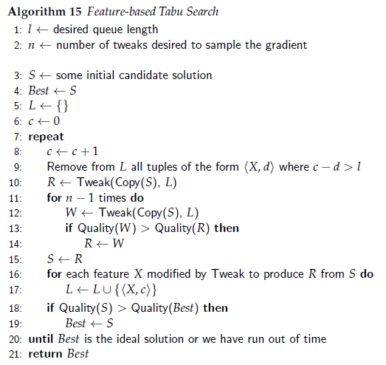

Slide 82
Remove old members
Current timestamp
Similar as before! Then where is the check for Taboo?????
Adding new members

Slide 83
Remove old members
Current timestamp
Tweak takes care of that. L is supplied to it!
Similar as before! Then where is the check for Taboo?????
Adding new members

Slide 84
Final Comments on F.B.T.S
Feature-based Tabu Search relies on the identifiability and separability of features found in candidate solutions
Other methods normally consider each candidate solution as an atomic element (except for Tweak purposes).

Slide 85
Iterated Local Search

Slide 86
ILS and H.C with Rand. Restarts
ILS is essentially a more clever version of Hill-Climbing with Random Restarts.
Hill-Climbing with Random Restarts:
Each time you do a random restart, the hill-climber then winds up in some (possibly new) local optimum.
We find a random local optimum, then another, then another, and so on
Eventually return the best optimum we ever discovered (ideally, it’s a global optimum!)

Slide 87
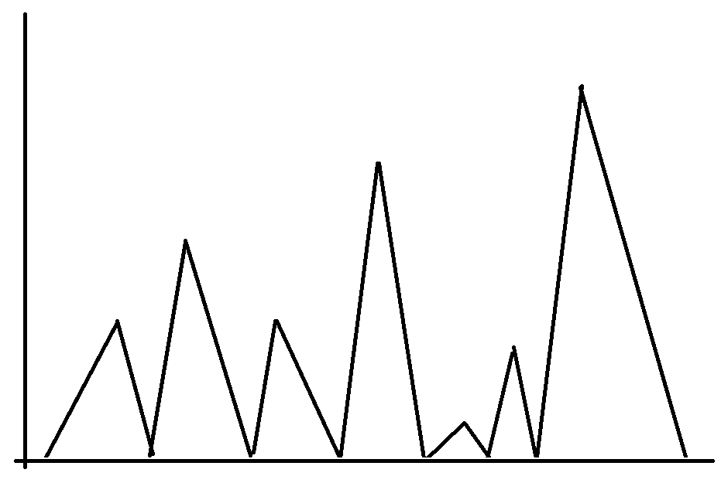
3
2
1
4

Slide 88
ILS and H.C with Rand. Restarts
Iterated Local Search:
ILS tries to search through this space of local optima in a more intelligent fashion:
ILS finds a local optimum
then looks for a “nearby” local optimum and possibly adopts that one instead,
then finds a new “nearby” local optimum, and so on.
The heuristic here is that you can often find better local optima near to the one you’re presently in,
walking from local optimum to local optimum in this way often outperforms just trying new locations entirely at random.

Slide 89
4
3
2
1

Slide 90
ILS Trick #1: Home Base
ILS doesn’t pick new restart locations entirely at random.
It maintains a “home base” local optimum
Selects new restart locations that are somewhat, though not excessively, in the vicinity of the “home base” local optimum.
The idea is to restart far enough away from our current home base to wind up in a new local optimum
but not so far as to be picking new restart locations essentially at random.

Slide 91
ILS Trick #2:Balancing exploration and exploitation
ILS does sth in between exploration and exploitation
when ILS discovers a new local optimum it makes a choice:
whether to retain the current “home base” local optimum,
or to adopt the new local optimum as the “home base”.
meta-exploration: always picking the new local optimum (i.e., random walk)
meta-exploitation: Always picking the new local optimum if it’s better than our current one (i.e., Hill Climbing)

Slide 92
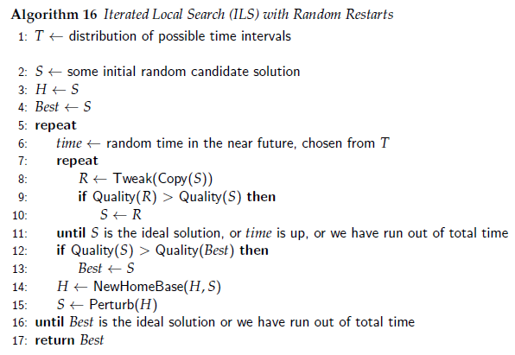

Slide 93
Current Home Base
Trying to get the local optima in the current hill.
Since, determining whether we got one is hard, we have a time bound as well!
Changing Home Base
A Big Tweak
Global Time bound

Slide 94
Perturb() Function
The goal of the Perturb function is to make a very large Tweak
“big enough” to likely escape the current local optimum
but not so large as to be essentially a randomization.
The meaning of “big enough” varies wildly from problem to problem.

Slide 95


NewHomeBase()
The goal of the NewHomeBase function is to “intelligently” pick new starting locations
remain between the extremes of exploration (random search and random walks) and exploitation (hill-climbing)
One Extreme:
The Other Extreme:
Always adopt the new one => random walk
a kind of hill-climbing among the local optima

Slide 96
NewHomeBase()
One Extreme:
The Other Extreme:
Middle Ground:
Option I:
ILS might hill-climb unless it hasn’t seen a new and better solution in a while,
at which point it starts doing random walks for a bit.
Option II: we could apply a Simulated Annealing approach to NewHomeBase
Option III: Tabu Search procedure of sorts.
Random Walk
Hill Climbing

